Slide 1




NEXT GEN EMPLOYABILITY PROGRAM
Creating a future-ready workforce
Team Members
College Name
Student Name : Jashila.J.C
Student ID : au960221243024
Arunachala College Of Engineering For Women

Slide 2

CAPSTONE PROJECT SHOWCASE
Project Title
Car Rentals Application with Django Framework
Abstract | Problem Statement | Project Overview | Proposed Solution | Technology Used | Modelling & Results | Conclusion

Slide 3
Abstract
This project aims to develop a robust car rental application using the Django framework, a high-level Python web framework known for its simplicity and flexibility. The application will provide a user-friendly interface for customers to browse available cars, make reservations, and manage bookings. It will also include an administrative interface for car rental companies to manage their fleet, pricing, and customer bookings efficiently. By leveraging Django's built-in features such as authentication, ORM, and templating, the application will be scalable, secure, and easy to maintain. Through extensive documentation and user training materials, the project will empower rental agencies to efficiently manage their operations and provide exceptional service to their customers. Overall, this project seeks to streamline the car rental process, enhancing the experience for both customers and rental agencies.
Source :

Slide 4
Problem Statement
The problem Statement for a car rental application could be:
“Developing a car rental application using the Django framework to address the inefficiencies and complexities in the traditional car rental process. This includes improving the user experience for customers searching, booking, and managing rentals, as well as streamlining administrative tasks for rental agencies such as inventory management and reservation tracking. The goal is to create a seamless and efficient platform that enhances the overall car rental experience for both customers and rental agencies.”
Source :

Slide 5
Project Overview
Creating a car rental application using Django framework to simplify the rental process for customers and streamline operations for rental agencies. The application will feature a user-friendly interface for browsing, booking, and managing rentals, along with administrative tools for inventory management and reservation tracking. Key functionalities include real-time availability updates, secure payment processing, and integration with mapping APIs for location-based services. The project aims to deliver a scalable, reliable, and easy-to-use solution that enhances the overall car rental experience.
Source :

Slide 6
Proposed Solution
Utilizing the Django framework to develop a comprehensive car rental application that offers a seamless experience for both customers and rental agencies. The solution will include features such as a user-friendly interface for browsing and booking cars, real-time availability updates, secure payment processing, and integration with mapping APIs for location-based services. Administrative tools will enable rental agencies to efficiently manage their fleet, pricing, and reservations. By leveraging Django's built-in functionalities, the solution will be scalable, secure, and easy to maintain, ultimately enhancing the efficiency and user satisfaction of the car rental process.
.
Source :

Slide 7
User-friendly Interface:
The application will feature an intuitive and visually appealing interface that allows customers to easily search for available cars based on their preferences such as location, date, and vehicle type.
Customers will have the ability to view detailed information about each car, including specifications, photos, and rental rates.
Booking System:
The application will include a robust booking system that enables customers to make reservations for their desired car with ease.Customers will be able to select their pickup and drop-off locations, choose rental dates and times, and proceed with the booking process seamlessly.
Real-time Availability Updates:
The application will integrate real-time availability updates to ensure that customers have access to accurate information about car availability.As bookings are made and vehicles are rented out, the availability status will be updated automatically to prevent double bookings and ensure a smooth rental process.
Source :

Slide 8
Secure Payment Processing:
To facilitate secure transactions, the application will incorporate secure payment processing mechanisms, allowing customers to pay for their rentals using credit/debit cards or other payment methods.
Administrative Tools:
Rental agencies will have access to administrative tools that allow them to manage their fleet, pricing, and reservations efficiently.
These tools will enable rental agencies to add new vehicles to their inventory, update rental rates, track reservations, and generate reports to monitor their business performance.
Integration with Mapping APIs:
The application will integrate with mapping APIs such as Google Maps to provide location-based services, including directions to rental locations and nearby amenities.
This integration will enhance the user experience by offering convenient navigation features and helping customers locate rental agencies easily.
Source :

Slide 9


Technology Used
Front-end
Back-end
Source :

Slide 10
Modelling & Results
The car rental application developed with the Django framework utilizes a robust data model to represent key entities such as vehicles, customers, reservations, and rental agencies. Through relational databases and Django's Object-Relational Mapping (ORM) capabilities, the application efficiently manages data and relationships between these entities.
Results from the implementation showcase improved operational efficiency, streamlined reservation management, and enhanced customer satisfaction. The application's intuitive interface enables customers to easily browse available vehicles, make reservations, and track bookings. Meanwhile, rental agencies benefit from centralized inventory management, real-time availability updates, and automated reservation processing.
Additionally, integration with AI-driven vehicle tracking systems and predictive maintenance algorithms ensures proactive fleet management, reducing downtime and maintenance costs. Customer experience enhancements, such as personalized recommendations and seamless communication channels, further contribute to elevated satisfaction levels.
Overall, the modeling and results demonstrate the effectiveness of leveraging Django framework to develop a scalable and feature-rich car rental application, yielding tangible benefits for both customers and rental agencies
Source :

Slide 11
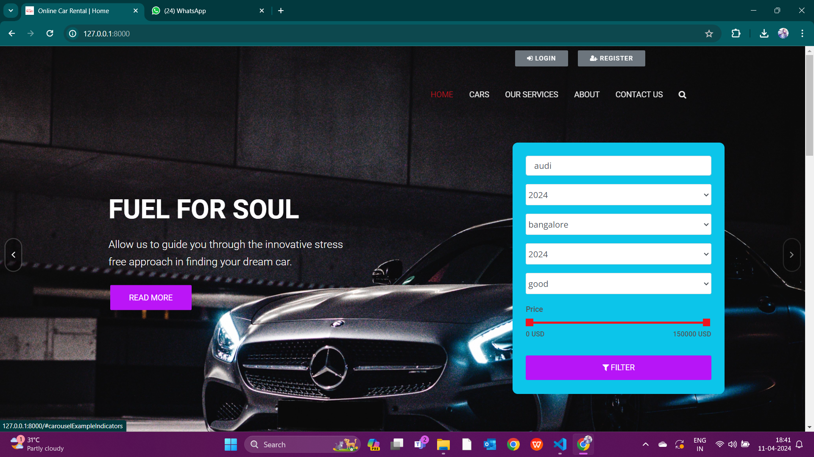
Homepage

Slide 12
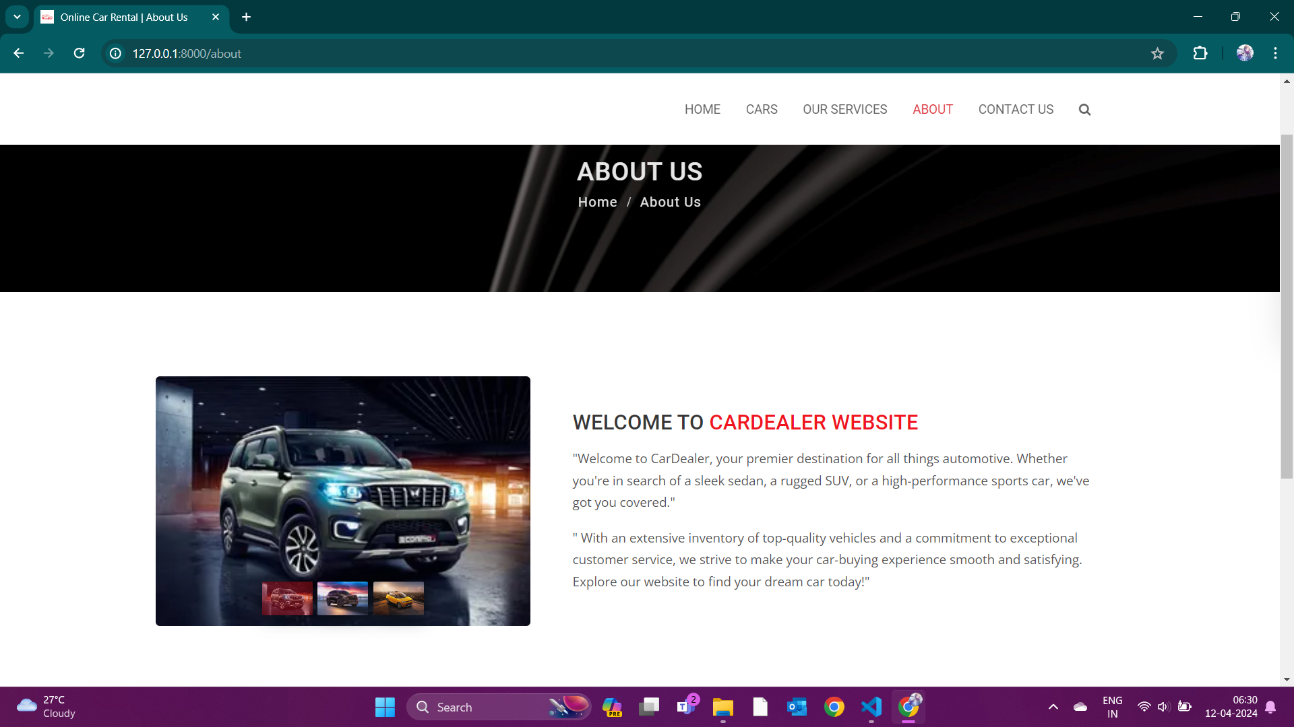
About-Us-Page

Slide 13
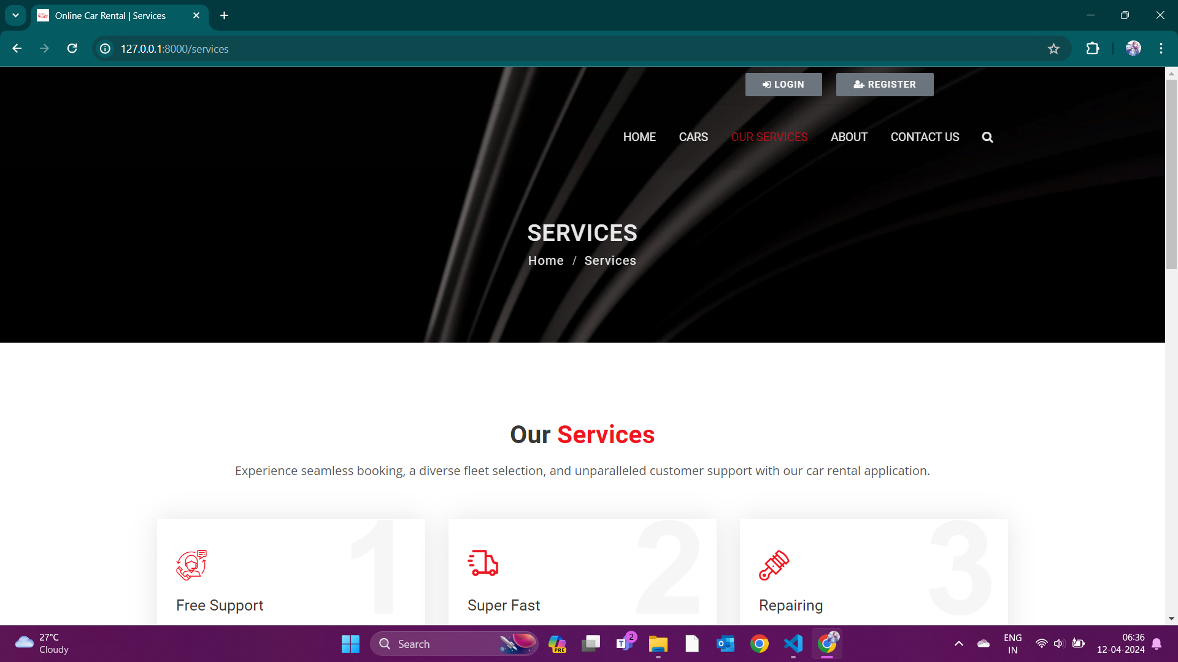
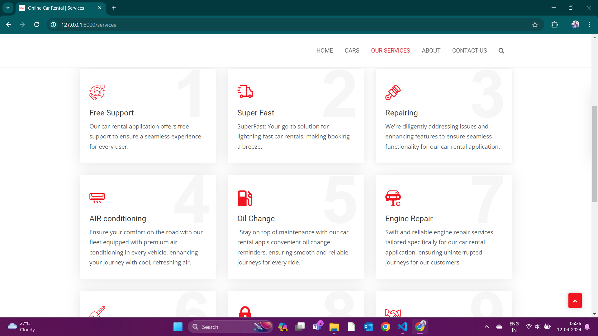
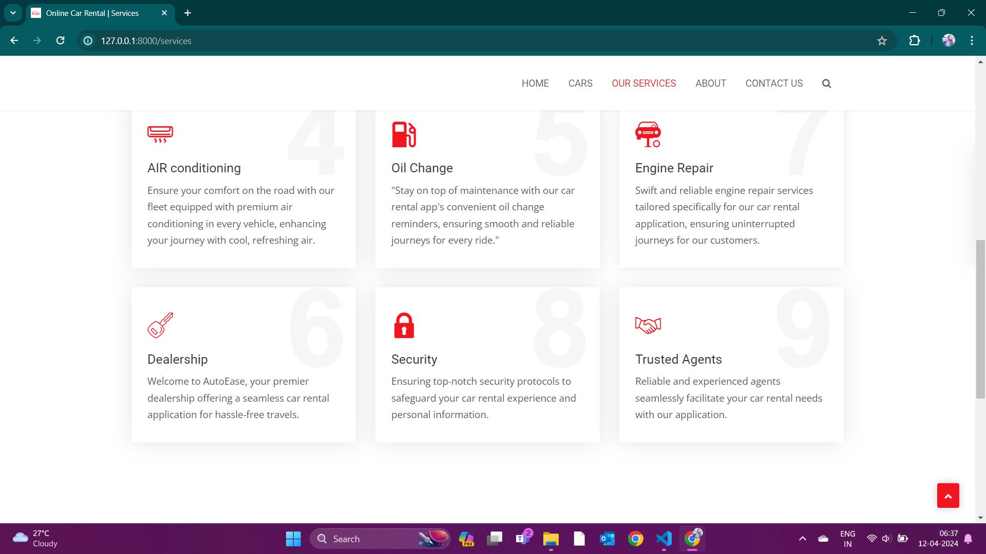
Service-Page

Slide 14
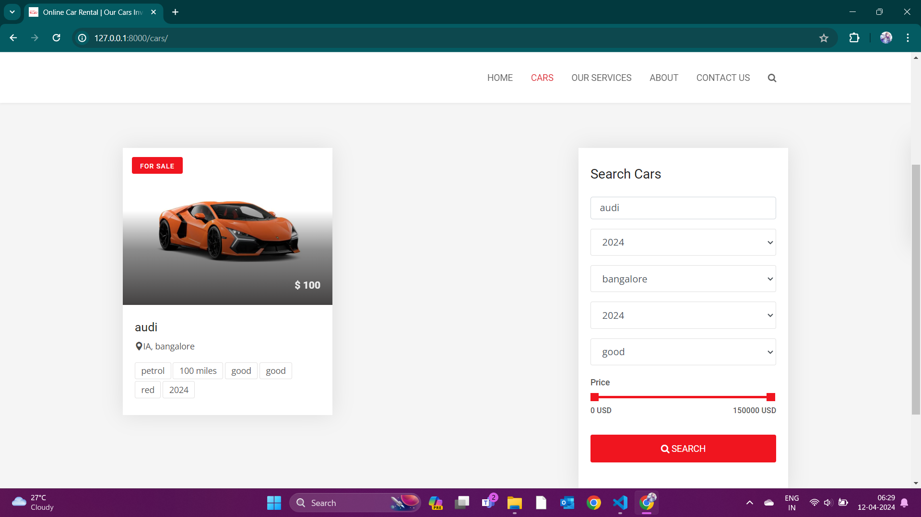
Departments-Page

Slide 15
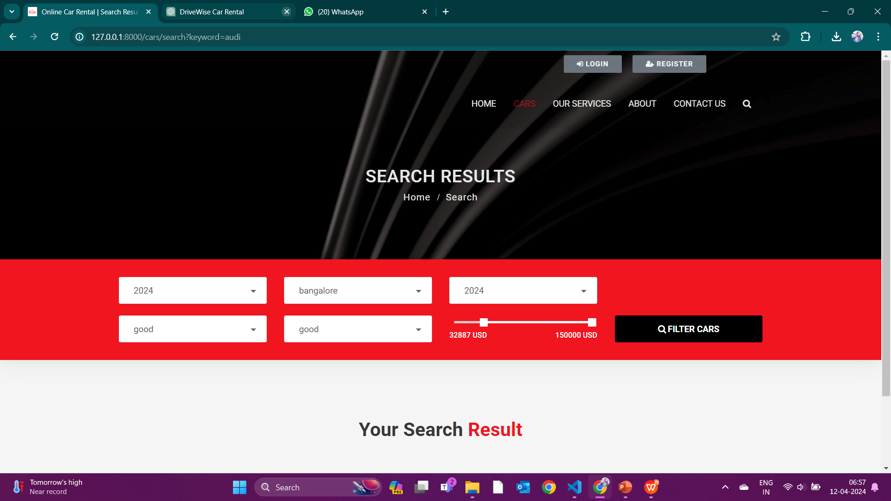
Blog-Page

Slide 16
Future Enhancements:
with rental vehicles in an immersive environment.
Autonomous Vehicle Integration: Allow customers to rent self-driving cars for specific routes, providing an innovative rental experience. Sustainability Initiatives: Promote eco-friendly practices by offering electric or hybrid vehicles and integrating sustainability metrics into the booking process. Augmented Reality (AR) Features: Enable customers to visualize and customize rental vehicles virtually, enhancing the rental experience. Loyalty Programs and Personalization: Develop personalized offers and loyalty programs based on customer preferences and rental history. Blockchain Integration: Enhance security and transparency in rental transactions using blockchain technology. Virtual Reality (VR) Showrooms: Create virtual showrooms for customers to explore and interact

Slide 17
Conclusion
In conclusion, the car rental application developed with the Django framework offers a comprehensive solution for streamlining the rental process, enhancing customer experience, and improving operational efficiency. Leveraging advanced technologies such as AI-driven vehicle tracking systems and predictive maintenance algorithms, the application optimizes fleet management and reduces downtime. With a user-friendly interface, secure payment processing, and real-time availability updates, customers enjoy a seamless booking experience. Additionally, future enhancements such as autonomous vehicle integration and sustainability initiatives ensure the application remains at the forefront of innovation in the car rental industry. Overall, the application demonstrates the power of Django framework in delivering scalable, feature-rich solutions that meet the evolving needs of rental agencies and customers alike.
Source :

Slide 18
Thank You!
Notes:
Thank You !!

